Slide 1




Mentor
Th.S Trịnh Sử Trường Thi
Nguyễn Lương Hoàng (Team Leader)
Nguyễn Đinh Thị Ngọc Diệp
Hứa Thị Thông
Trần Văn Thành
Nguyễn Ngọc Vũ
Team member

Slide 2
OVERVIEW
INTRODUCTION
DEVELOPMENT
DEMO
Q&A

Slide 3



INTRODUCTION
Notes:
House seekers:
+ Especially, young people who are students or newly-graduated students, they don’t have much money to own a house, so they would prefer to rent a house or a room. But it would take them a lot of time and efforts to find a place they love.
+ Must be go around the location they want to renting but they don’t know about the price and hostel capacity…
+ Spend a lot of time to finding hostel suitable with themselves
+ Therefore, Renting Helper is created with the purpose of helping house seekers to find their beloved home in an effortless and fastest way.
Hostel Owner:
+ They must be promote their hostel for rent by poster or via broker
+ Must be pay for brokerage fees

Slide 4

INTRODUCTION
Finding renting house/room
PROPOSED SOLUTION
Posting house/room for rent
Viewing place on map
Contact house owner
Rating marks for renting place
Notes:
- Finding renting house/room With filter by distance, price, capacity
- Posting house/room for rent
- Viewing place on map
- Contact house owner by supplied phone number
- Rating marks for renting place

Slide 5
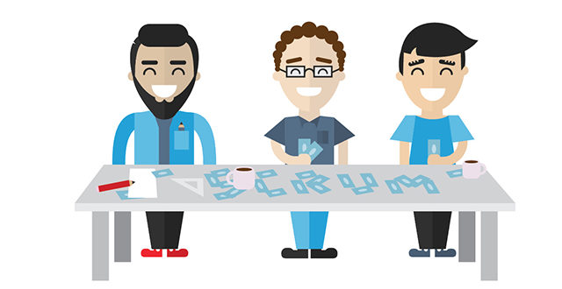
DEVELOPMENT
Notes:
Why we develop with scrum:
+ Fit for short time project
+ Members can support eachothers
+ Manage tasks, resolve issue everday via daily meeting
+ Release bundle each 2 weeks to modify asap
+ Next about manage task

Slide 6









DEVELOPMENT
Notes:
Technical:
+ Android
+ .Net Core
+ MongoDb
+ Amazon S3
Development tools:
+ Android Studio
+ Visual Studio
+ GitLab
+ Trello
Why use Android? -> This mobile OS is very popular and easy to development
Why use MongoDb? -> It’s non SQL, MongoDB is a document database with the scalability and flexibility that you want with the querying and indexing that you need
- AWS S3 -> Supported storage uploaded file with bucket and easier to access from clients.

Slide 7
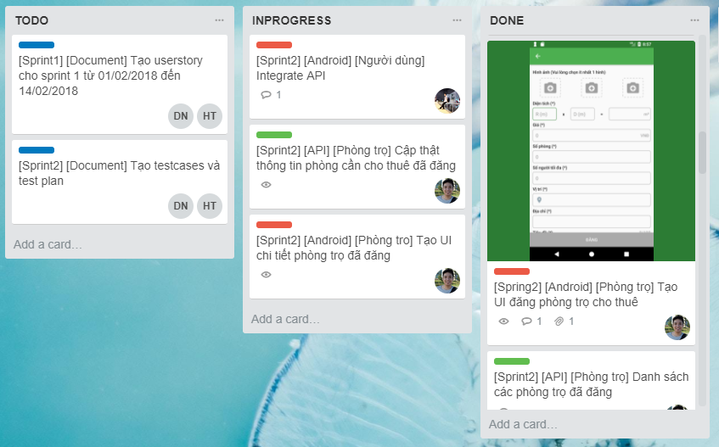
DEVELOPMENT
Notes:
Manage task with Kanban

Slide 8
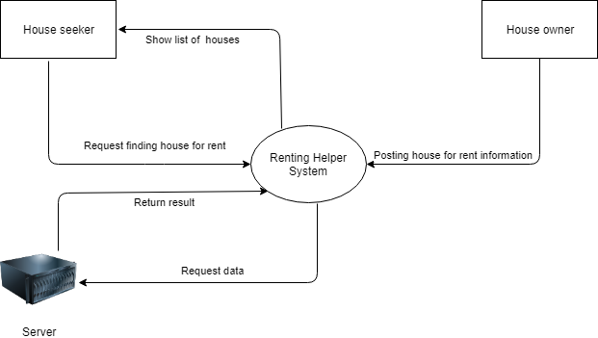
DEVELOPMENT

Slide 9
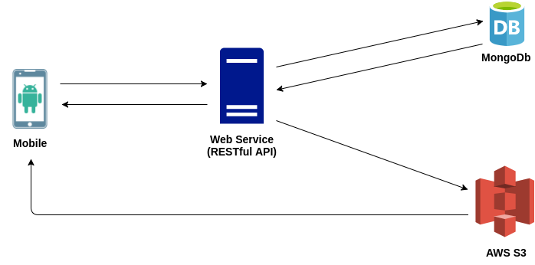
DEVELOPMENT

Slide 10
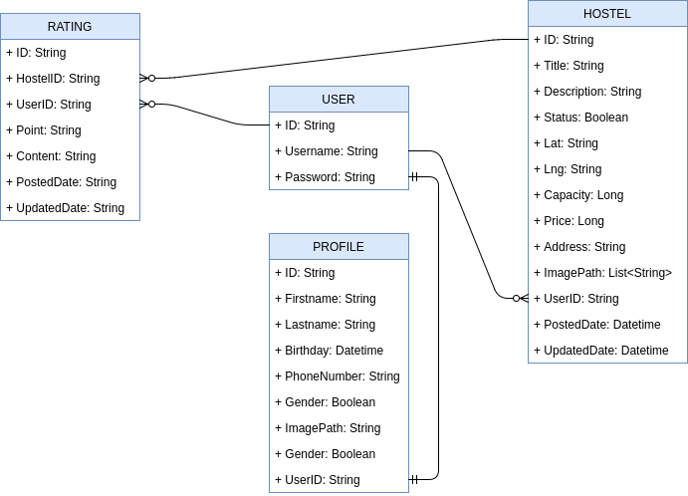
DEVELOPMENT

Slide 11
DEMO

Slide 12

REVIEW
Complete project goals
Result
Technical skills
Communication skills
System performance
Limitation
Stability and scalability
Extra requirements
Notes:
* Result
- Learn the process of building a mobile software with new technologies such as Google Map, open source libraries, and new designs that make the product look more beautiful and user-oriented.
- Apply the knowledge learned in product development.
- Improve the responsibility of work, self-discipline, seriousness, punctuality.
- Improve reading comprehension skills - understand English.
- Drawing on valuable experience, self-learning, self-study, soft skills as well as working environment in professional and new perspective on future work.
Limitation
- Due to limited knowledge and experience as well as programming skills, the software products are still simple and have not been fully implemented.
- Not yet implement new posted house approval feature
- Not yet implement push notification when a house is rated
- Not yet implement shared room/house feature
- The program is only focused on a major function, not yet usable on a large scale.

Slide 13


Slide 14
Thank you!

